Slide 1

Project Plan
Doctor’s Appointment Booking System-
Medi-Book
By Amelia Goldsby

Slide 2

PLanning

Slide 3
Scope
The local Doctor’s currently allows appointments to be booked through telephone calls, and emails. Appointments can be booked from 8am on weekdays, which causes a huge backlog with people waiting in the telephone queue. This overall creates a dissatisfied service for customers and resulted in bad reviews and complaints.
A new system/app is to be developed to increase customer satisfaction but also aid receptionists with allowing an easier workday.
It must allow a form completion service, which is sent to the receptionists to converse with the duty nurse/doctor with their opinion on booking a consultation.

Slide 4
Key Stakeholders
Key:
Colour | Representation
Green | Internal
Blue | External
The list of stakeholders includes:
  Executive Sponsor- Funding the project from a top level, so will be keen to understand the benefits and projects’ intentions.
  IT Business Partner- Overlooks all IT software and infrastructure in a specific area, including for this project. They are not specific to one project; therefore, involvement is low.
  Product Owner- Responsible for the change, with working closely with the business to create the strategy/vision to produce a product backlog and convenes meetings.
  Product Manager- Allocates resources (including time, money, etc…) and helps with scheduling.
  Developers- A team who are responsible for developing the actual project, will be very involved with the project, which is dependent on their developing times.
  Testers- A team who are responsible for vigorous testing of the project, ensuring it meets its objectives successfully.
  Business Analysts- Analyses the issue to create and prioritise the requirements for the project using visual representation, including charts and designs, etc..
  Solutions Architects- Responsible for understanding technical integrations between different systems and services and ensure best practices are adhered to from a security and infrastructure point of view.
  Customers- Customers who wish to book a consultation or appointment, which could be routine or one of a time. Their feedback is also important as they will be impacted with the new project, hopefully, creating better customer satisfaction.
  Other Doctor Practices- It is important to keep an eye on competitors to see what changes they are making within their company and the impact it creates. Furthermore, it’s also important to keep up to date with the constant changes with other competitors.

Slide 5
Stakeholder Management Plan
Stakeholder | Interest Level | Communication Plan
Executive Sponsor | High | Fortnightly- emails, calls informing of progress and targets being met, including the benefits of each stage
IT Business Partner | High | Fortnightly- emails, calls with updates on progress
Product Owner | High | Daily- daily stand-up calls to run through kanban board and retrospectives including any issues for the team, emails may also be an option
Product Manager | High | Fortnightly- retrospectives to review last sprint including any issues which have occurred
Developers | High | Daily- daily stand-up calls to review progress and assign stories, including discussing any issues found
Testers | High | Daily- daily stand-up calls to review progress and assign stories, including discussing any issues found
Business Analysts | High | Daily- daily stand-up calls to review progress and assign stories, including discussing any issues found
Solutions Architect | High | Daily- daily stand-up calls to review progress and assign stories, including discussing any issues found
Customers | Medium | When project is being deployed- emails and surveys to retrieve useful feedback to prove the benefits of the project. Surveys before the development is also crucial to understand the customer needs
Other Doctor’s Practices | Low | Monitor to understand any changes other practices make to keep with current trends

Slide 6
Stakeholder Analysis
Power
High
Keep Satisfied
Manage Closely
Monitor
Keep Informed
Executive Sponsor
Product Owner
Business Analysts
Testers
Business IT Partner
Developers
Interest
Low
High
Customers
Product Manager
Solutions Architect
Competitors
Low

Slide 7
Survey Plan
For a survey to be effective the following must be planned/discussed before conducting it.
Value
The purpose of this project is to introduce a new system to request appointments for customers. If an error is made, the cost is high and means this could be a waste of time and resources. The amount of uncertainty is Moderate, due to the clear need of a new system, but what is the question.
Cost
The survey is to be conducted over the phone, by choice, when someone books an appointment or makes a phone call. It can also be conducted by email or on their website. A web survey has lower costs, but less customers are going to complete it.
Objective Statement
Measure the number of customers calling daily for the next month, whilst also conducting a feedback survey to receive feedback for requirements.
Audience
The audience not only includes customers, but also staff which daily tasks include dealing with appointments. Employees intend to ask every customer who calls if they wish to complete the survey, either on phone or email. An email should also be sent out to a large number of customers asking them to complete it, as well.
Timeline
The timeline for the whole project is 1 year but has leniency and includes time set aside as a contingency plan. For the survey, customers and staff should be given approximately a month.

Slide 8
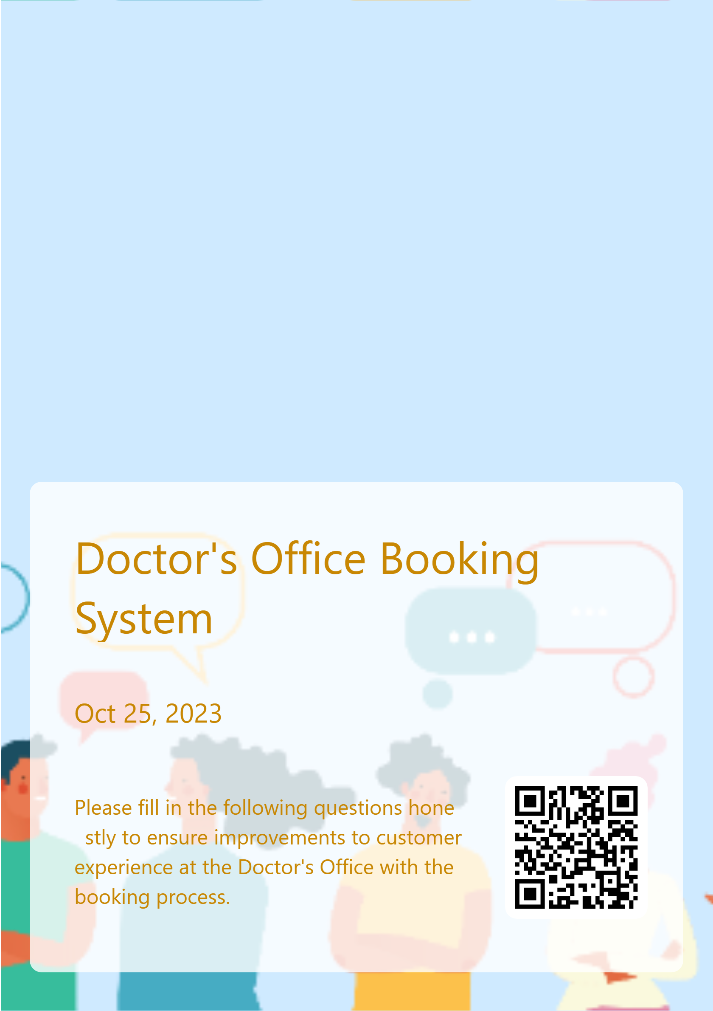
Survey Example
I have created an example survey to showcase example questions, which would allow customer requirements to be collected.
A forms survey is an easy and user-friendly application which would be sent over email but also be completed on the phone and uploaded to a website if necessary.
Below is the link and to the side is the QR code to the survey:
https://forms.office.com/e/mL6d9ETeJj

Slide 9




Survey Answers
After sharing the survey out to all the patients registered under the doctor’s office via email and asking them to complete the survey over phone when calling the surgery.
We received an average result of 45% of patients use the original system to book an appointment, routine or one-off, every month. The average rating of the current system is 3.29/10 which shows that not only is there a clear need for improvement, but especially due to the frequency that patients use it. Some examples of feedback on the current system are on the top right.
The main improvement suggested was to make the booking system faster to use but there was some notable feedback with worries from patients that the new proposed system may be confusing. This has emphasised the focus of ensuring the app will be customer-focused on their needs, and to make it user friendly. Some feedback can be seen on the bottom right.

Slide 10
MOSOCOW Prioritisation
M
Must Have:
- Form to book an appointment
- Loading Screen
S
Should Have:
- Allow customers to update their contact details on appointment request
- Allow preference on appointment days
- A sign in area
C
Could Have:
- Past appointments
- Current medications
W
- Be user-friendly
-Confirmation of Appointment Request
-Have contact details of the practice
-Availability of Appointments
Won’t Have:
Allow online consultations- through messages and video calls

Slide 11
Software Requirements
The survey, like the example on slide 8, will allow the requirements of customers to be collected and used to ensure the program will be beneficial and meet the expectations they have set. Not only do we have these requirements, but requirements which are pre-defined, split into functional (an action which must be allowed to be performed) and non-functional (behaviours of the program) requirements…
Functional | Non-Functional
Users should be able to complete a form for an appointment. | The app must be user friendly
Users should be able to see available appointment dates | The app must be able to be accessed on different devices
Users should be able to select what type of appointment they would like- routine or one off | The app must allow a larger volume of customers to use the app, around 8am
Users should be able to update their contact details so their appointment can be confirmed | The app must be quick to increase performance
Users should be able to have confirmation when a form is submitted | The app must keep data for appointments for minimum 2 years

Slide 12

Project Design

Slide 13
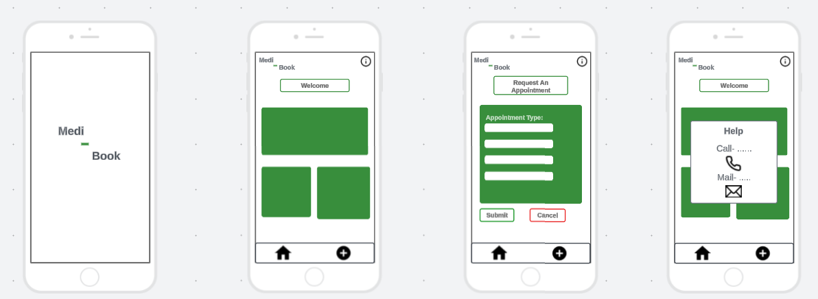
UI Wireframe
The name
‘Medi-Book’ allows for
future expansion of the app- even though its intended app is to use for one specific doctor’s surgery, in the future there may
be an option to cover more surgeries as well.
I have used Lucid to create wireframes for my app and have included all the must-have requirements from slide 9, whilst also allowing further development and improvements to also include further requirements.

Slide 14
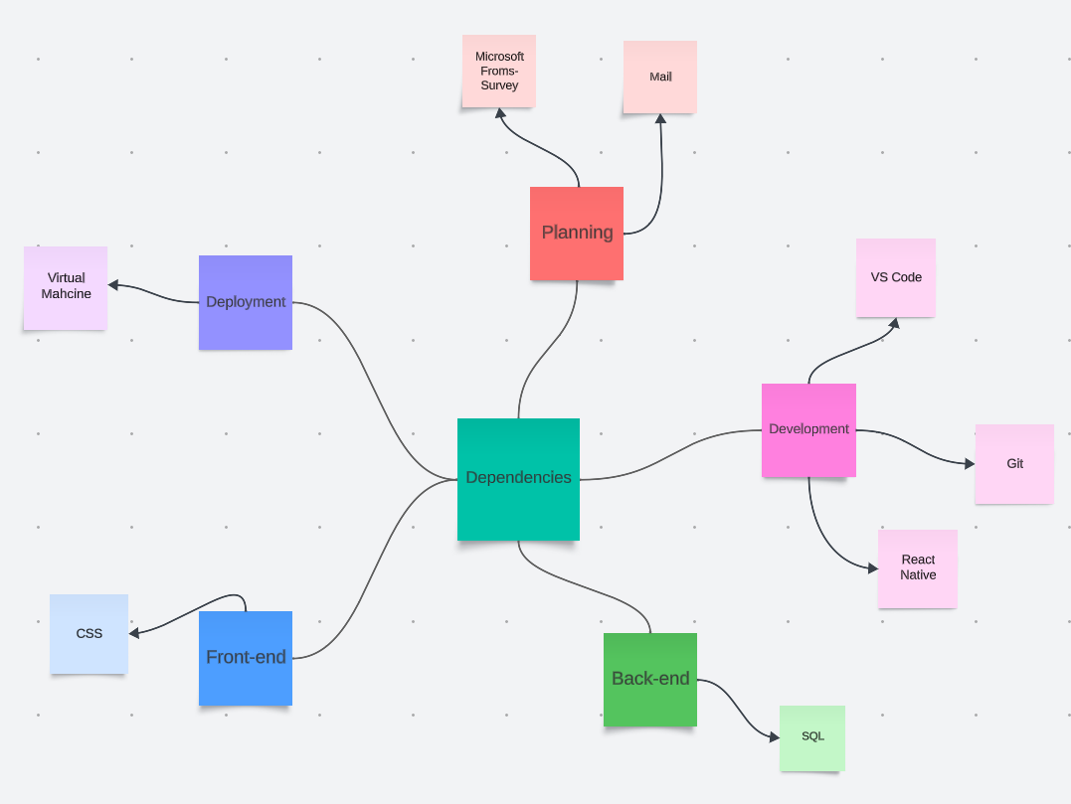
Dependencies/Requirements
There are dependencies, which all have different risks and involvement depend on the stage of the agile lifecycle that the project is on. On the right, I have created a mind map to show these dependencies.

Slide 15
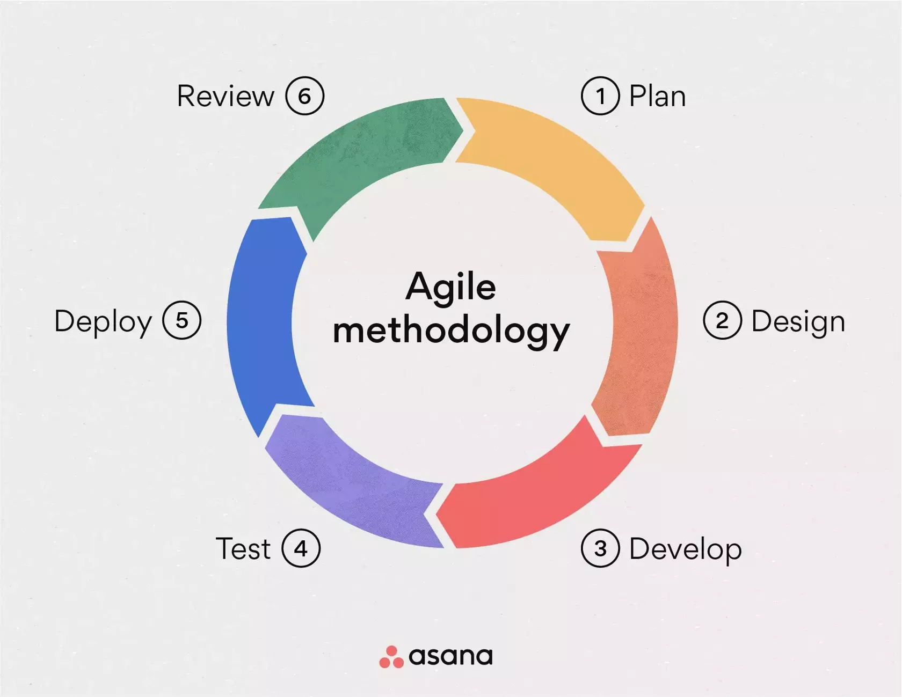
Development/Deployment Approach
For the development phase, the Agile Methodology made most sense, with it being used in most modern technology companies and allows adaptability, which is a major benefit, especially when requirements are constantly changing.
There is no specific timeline for this app, nor a constraint of a small budget, due to the growing need of a new booking process.
Advantages | Disadvantages
Quick deployment | Progress hard to measure
Customer-focused development | Scope creep
Resources used effectively and not wasted
Issues fixed quickly

Slide 16
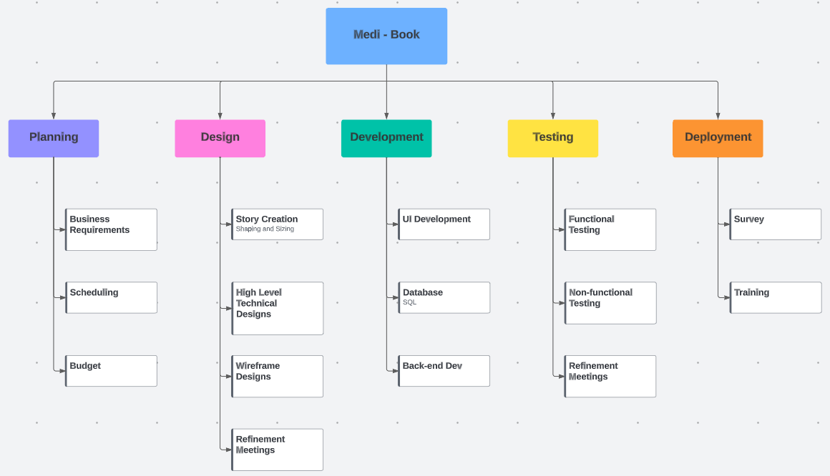
Work Breakdown Structure
I have created a WBS to show the stages of each of the agile methodology lifecycle, with relevant main tasks under each section.

Slide 17

Project Implementation

Slide 18
Initial Estimates
Stage | Average Score/Weeks Estimated
Plan | 3 weeks
Design | 5 weeks
Development | -
Loading Screen | 2 weeks
Home Screen | 3 weeks
Booking Screen | 5 weeks
Confirmation Screen | 2 weeks
Testing | 7 weeks
Deployment | 2 weeks
Review | 1 week
For the estimates I have chosen to use the planning poker method.
Like poker, each member gets a deck of cards, but in this instance, all members have the same cards- usually based off the Fibonacci sequence to produce cards with the numbers 0, 1, 2, 3, 5, 8, 13, 20, 40, and 100.
The cards represent the estimated time that the section will take to complete, and the numbers are then collected and averaged to then collate into a diagram, like a Gantt Chart.
For the Medi-Book app, this process has been implemented to create estimates for the stages of the agile lifecycle, but also sections of the development. We used 6 members of the team who have experience with involvement in the agile lifecycle in software development.

Slide 19
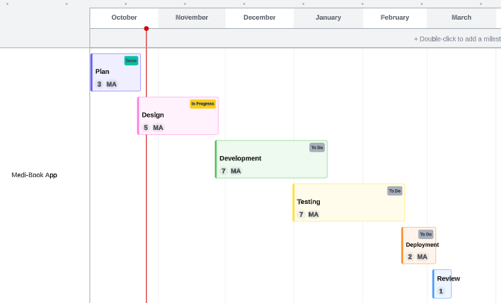
Gantt Chart
From the initial estimates, a Gantt chart has been produced, visualising the estimated number of weeks for each section of the lifecycle.
It is noted that part of the testing is overlapped with the development, this is due to the knowledge that parts of the development, like the loading and confirmation screen, which will only take 2 weeks to complete, meaning these sections can be tested and prepared for deployment, whilst the rest of the development is being completed.
The estimated finish date is 11th March 2024, however there is leniency as the deadline is 30th March, allowing for the risk of errors in the development, etc…

Slide 20
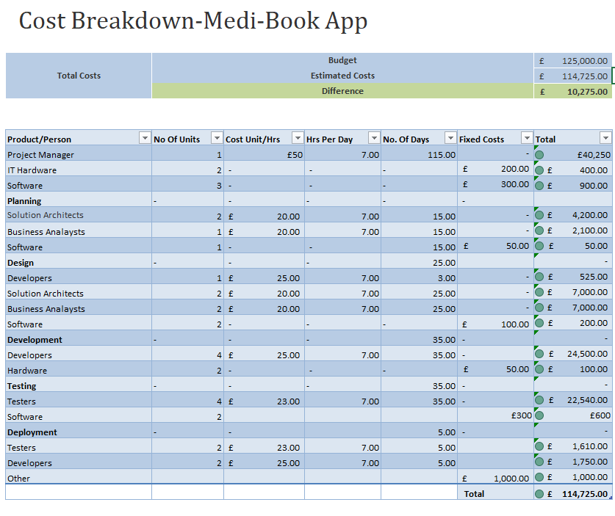
Estimated Costs
From the initial estimates and Gantt Chart I have created an estimated cost breakdown table.
To the right you can see that the budget is £125,000 and the estimated costs are only £114,725- which allows £10,275 to be spare to cover for any errors occurring, e.g., like the development being slower than estimated.

